Slide 1
Flip Flops & it’s Applications
Made By : Kaustubh S. Wade
Enroll. No : 160410116050

Slide 2
Flip Flops
Flip-flops are digital logic circuits that can be in one of two states(0,1).
Flip-flops maintain their state indefinitely until an input pulse called a trigger is received.
When a trigger is received, the flip-flop outputs change state according to defined rules and remain in those states until another trigger is received.
Flip-flops can be used to store one bit, or binary digit, of data.
There are several different kinds of flip-flop circuits, with designators such as T (toggle), S-R (set/reset) J-K and D (delay).
A flip-flop typically includes zero, one, or two input signals as well as a clock signal and an output signal.

Slide 3
S-R Flip Flop
The SET-RESET flip flop is designed with the help of two NOR gates and also two NAND gates.
The design of such a flip flop includes two inputs, called the SET [S] and RESET [R].
There are also two outputs, Q and Q’.

Slide 4
Characteristic Table
Q | S | R | Q(t+1)
0 | 0 | 0 | 0
0 | 0 | 1 | 0
0 | 1 | 0 | 1
0 | 1 | 1 | Not Allowed
1 | 0 | 0 | 1
1 | 0 | 1 | 0
1 | 1 | 0 | 1
1 | 1 | 1 | Not Allowed

Slide 5
D Flip Flop
D flip flop is actually a slight modification of the above explained clocked SR flip-flop.
The D flip-flop tracks the input, making transitions with match those of the input D.
A D flip-flop can be made from a set/reset flip-flop by tying the set to the reset through an inverter.

Slide 6
Characteristic Table
Q | D | Q(t+1)
0 | 0 | 0
0 | 1 | 1
1 | 0 | 0
1 | 1 | 1

Slide 7
J-K Flip Flop
A J-K flip flop can also be defined as a modification of the S-R flip flop.
The only difference is that the intermediate state is more refined and
precise than that of a S-R flip flop.
The behaviour of inputs J and K is same as the S and R inputs of the S-R flip flop.
The letter J stands for SET and the letter K stands for CLEAR.

Slide 8
Characteristic Table
Q | J | K | Q(t+1)
0 | 0 | 0 | 0
0 | 0 | 1 | 0
0 | 1 | 0 | 1
0 | 1 | 1 | 1
1 | 0 | 0 | 1
1 | 0 | 1 | 0
1 | 1 | 0 | 1
1 | 1 | 1 | 0

Slide 9
T Flip Flop
This is a much simpler version of the J-K flip flop. Both the J and K inputs are connected together and thus are also called a single input J-K flip flop.
When clock pulse is given to the flip flop, the output begins to toggle.

Slide 10
Characteristic Table
Q | T | Q(t+1)
0 | 0 | 0
0 | 1 | 1
1 | 0 | 1
1 | 1 | 0

Slide 11
Master Slave Flip Flop
Master-slave flip flop is designed using two separate flip flops.
One flip-flop acts as the “Master” circuit, which triggers on the leading edge of the clock pulse while the other acts as the “Slave” circuit, which triggers on the falling edge of the clock pulse.

Slide 12
Characteristic Table
J | K | Q(t) | Q(t+1)
0 | 0 | 0 | 0
0 | 0 | 1 | 1
1 | 0 | 0 | 1
1 | 0 | 1 | 1
0 | 1 | 0 | 0
0 | 1 | 1 | 0
1 | 1 | 0 | 1
1 | 1 | 1 | 0

Slide 13
Applications
Frequency dividers
Shift registers
Counters

Slide 14
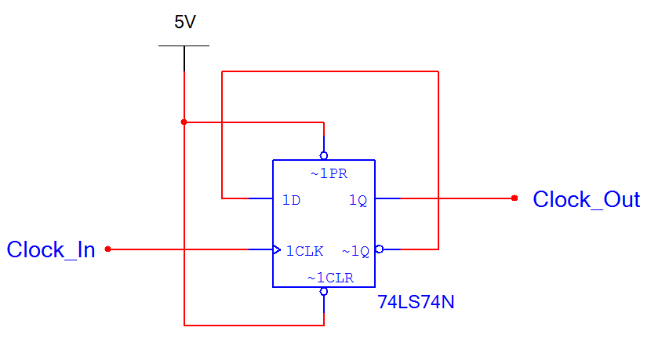
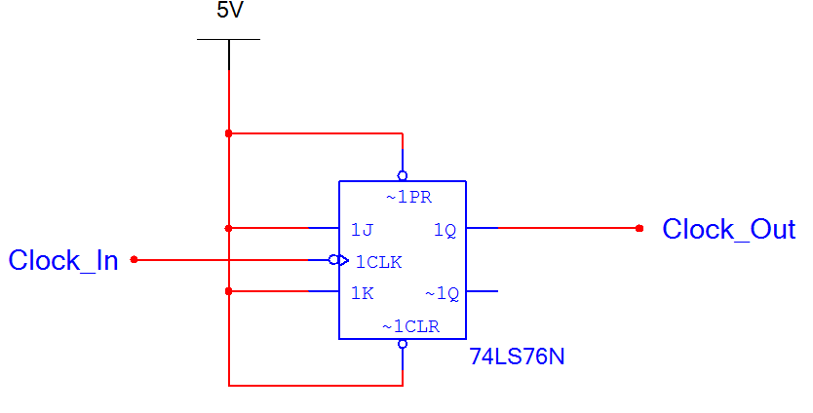
Frequency Divider
As the name implies, a frequency divider is a circuit the produces a digital output signal that is half the frequency of the input.
The frequency divider is used extensively in the design of asynchronous counters.
D Version
J/K Version

Slide 15
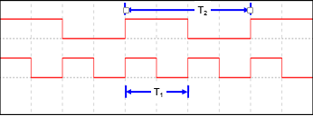
Clock_Out
Clock_In
The period of Clock_Out is twice the period of Clock_In.
Since the period is twice, the frequency is divided in half.

Slide 16
Shift Register
A shift register is a group of flip-flops (typically 4 or 8) that are arranged so that the values stored in the flip-flops are shifted from one flip-flop to the next for every clock.
Shift registers are used extensively in logic circuits to control digital displays.
A classic example is numbers being typed into a calculator. As the numbers are entered, the digits shift to the left one position. This shifting is controlled by a shift register.

Slide 17
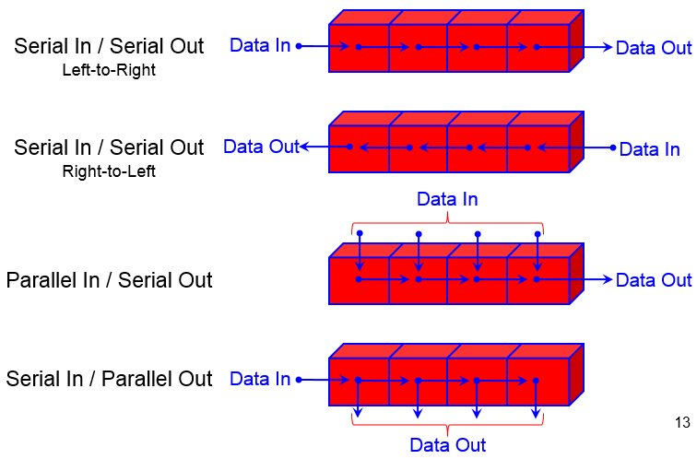
Shift Register : Types

Slide 18
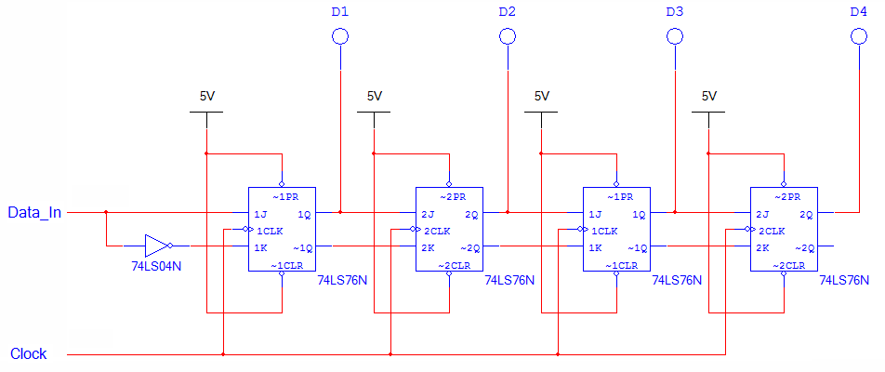
Shift Register : Circuit

Slide 19
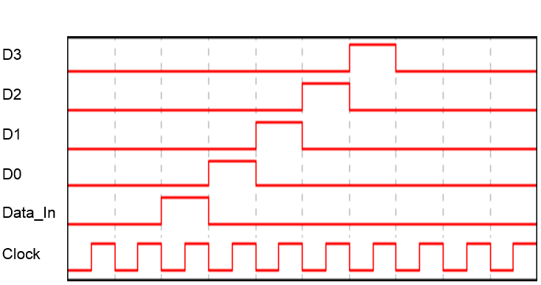
Shift Register : Timing

Slide 20
Counters
A counter is a digital sequential logic device that will go through a certain predefined states (for example counting up or down) based on the application of the input pulses. They are utilized in almost all computers and digital electronics systems.
There are two main types of counters: Asynchronous and Synchronous counters.

Slide 21
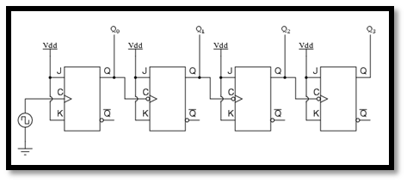
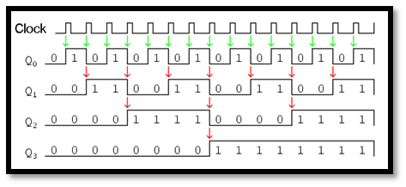
Asynchronous Counters
The output waveforms

Slide 22
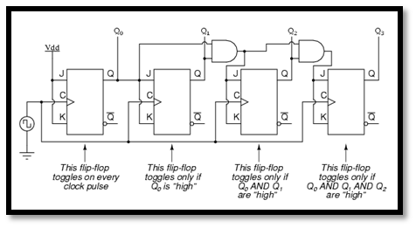
Synchronous Counters
This type of counters has each flip-flop clocked by the same clock source, thus eliminating the cumulative delay found in asynchronous counters.

